Slide 1
NEWER ANTIANGINALS
Dr Ajay Nair

Slide 2
Despite the advances in medical and interventional therapies a significant number of patients with ischemic heart disease and angina pectoris cannot be successfully managed.

Slide 3
Unsuitable anatomy
One or several prior revascularization procedures
Lack of vascular conduits for CABG
Severely impaired left ventricular function in patients with previous CABG or PCI
Co -morbidities
Age, often in combination with other factors

Slide 4
HISTORY OF ANTI ANGINAL THERAPY
1867 : NITRATES
1962 : BETA BLOCKERS
1960 : CABG
1977: PCI
1982 : CCBs
2006: RANOLAZINE

Slide 5
Current therapies that reduce angina include :
Drugs :Nitrates, β-blockers, Calcium antagonist
Exercise conditioning
Coronary revascularization

Slide 6
TMR
EECP
Chelation
therapy
Exercise training
Non pharmacologic
SCS
Newer anti-anginal strategies
Fasudil
Pharmacologic
Nicorandil
Trimetazidine
Ivabradine
Ranolazine
Notes:
The three main nonpharmacologic antianginal techniques currently under evaluation are enhanced external counterpulsation, transmyocardial revascularization, and spinal cord stimulation. They are generally reserved for refractory angina.
EECP uses three paired pneumatic cuffs that are applied to the lower extremities. The cuffs are sequentially inflated then deflated.
TMR involves the creation of channels in the myocardium with a laser.
SCS uses an implanted device with an electrode tip that extends into the dorsal epidural space, usually at the C7-T1 level.¹
Their mechanisms of action are not completely understood and a number of hypotheses have been proposed.
Current nonpharmacologic antianginal strategies
Gibbons RJ, Abrams J, Chatterjee K, Daley J, Deedwania PC, Douglas JS, et al. ACC/AHA 2002 guideline update for the management of patients with chronic stable angina: A report of the American College of Cardiology/ American Heart Association Task Force on Practice Guidelines (Committee to Update the 1999 Guidelines for the Management of Patients with Chronic Stable Angina). 2002. Available at www.acc.org/clinical/guidelines/stable/ stable.pdf.

Slide 7
Advances
Improved understanding of ischemia has prompted new therapeutic approaches
  Rho kinase inhibition
  Metabolic modulation
  Preconditioning
  Inhibition of I_{f} and late INa currents
Notes:
Ischemic heart disease and associated symptoms continue to present a major public health challenge.
A number of new therapeutic approaches are under investigation, including
Rho kinase inhibition
Metabolic modulation
Preconditioning via K⁺ channel activation
Inhibition of I_{f} and late I_{Na} currents
Two of these approaches (late I_{Na} inhibition and inhibition of fatty acid oxidation) reduce angina with minimal or no pathophysiologic effects. Thus, they are potentially complementary to traditional medications (beta-blockers, calcium channel blockers,
and nitrates).
Summary

Slide 8
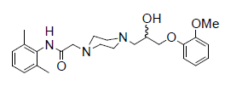
Ranolazine
It is a substituted piperazine compound.
pFOX
Late sodium current blocker

Slide 9
Understanding Angina at the Cellular Level
Ischemia
Ischemia impairs cardiomyocyte sodium channel function
Impaired sodium channel function leads to:
  Pathologic increased late sodium current
  Sodium overload
  Sodium-induced calcium overload
Calcium overload causes diastolic relaxation failure, which:
  Increases myocardial oxygen consumption
  Reduces myocardial blood flow and oxygen supply
  Worsens ischemia and angina
↑ Late I_{Na}
Ranolazine
Na⁺ Overload
Ca⁺⁺ Overload
Diastolic relaxation failure
Extravascular compression
Chaitman BR. Circulation. 2006;113:2462-2472
Notes:
Ischemia is associated with disruptions in cellular sodium and calcium homeostasis.
An enhanced late sodium current is likely to contribute to the sodium overload observed in ischemia. Late phase sodium channels have been shown to remain open longer in ischemic conditions. Sodium overload may result from decreased efflux and increased influx during ischemia, with greater intracellular accumulation of sodium as the duration of ischemia increases.
This is followed by an increase in intracellular Calcium through the Na/Ca exchanger on the myocyte wall.
Ju YK, Saint DA, Gage PW. Hypoxia increases persistent sodium current in rat ventricular myocytes. J Physiol. 1996;497 ( Pt 2):337-347.
Murphy E, Perlman M, London RE, Steenbergen C. Amiloride delays the ischemia-induced rise in cytosolic free calcium. Circ Res. 1991;68:1250-1258.
Jansen MA, van Emous JG, Nederhoff MG, van Echteld CJ. Assessment of myocardial viability by intracellular 23Na magnetic resonance imaging. Circulation. 2004;110:3457-3464.

Slide 10
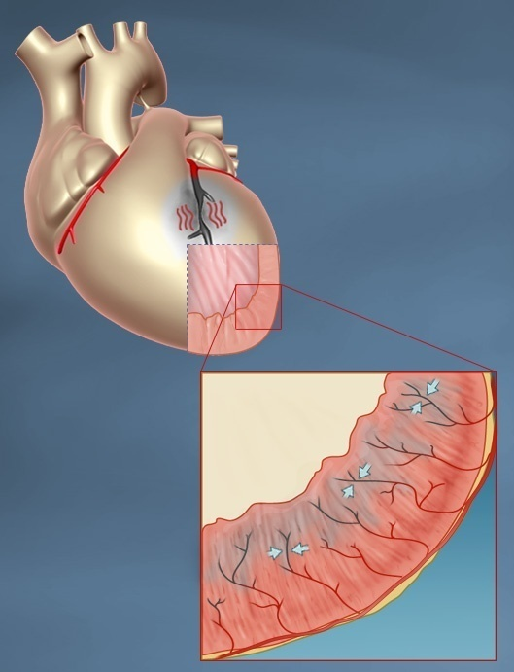
Diastolic relaxation failure increases oxygen consumption and reduces oxygen supply
Increased myocardial tension during diastole:
  Increases myocardial O₂ consumption
  Compresses intramural small vessels
    Reduces myocardial blood flow
  Worsens ischemia and angina
Notes:
Cellular calcium overload causes impaired contractility and, more significantly, impaired relaxation.
Sustained contraction of the ischemic cardiomyocyte during diastole, or diastolic relaxation failure, consumes energy.
This increases the demand for oxygen and worsens ischemia and angina.
Sustained contraction of the ischemic cardiomyocyte during diastole, or diastolic relaxation failure, also causes compression of the intramural vessels that supply the myocardium with blood and oxygen.
This significantly reduces myocardial blood flow and oxygen supply, since most blood flow to the heart occurs during diastole.
As a consequence, ischemia and angina become worse.
Meyer M, Keweloh B, Guth K, Holmes J, Pieske B, Lehnart S, Just H, Hasenfuss G. Frequency-dependence of myocardial energetics in failing human myocardium as quantified by a new method for the measurement of oxygen consumption in muscle strip preparations. J Mol Cell Cardiol. 1998;30:1459-1470.
Zile MR, Baicu CF, Gaasch WH. Diastolic heart failure—abnormalities in active relaxation and passive stiffness of the left ventricle. N Engl J Med. 2004;350:1953-1999.

Slide 11
Ranolazine – hemodynamic affects
No affect of Blood Pressure or Heart Rate
Can be added to Conventional Medical therapy, especially when BP and HR do not allow further increase in dose of BetaBlockers, Ca Channel blockers, and Long Acting Nitrates.
Ranolazine has twin pronged action.
  pFOX
  Late Na inward entry blockade ( MAJOR MECHANISM)

Slide 12
Pharmacologic Classes for Treatment of Angina
Medication Class | Impact on HR | Impact on BP | Physiologic Mechanism
Beta Blockers |  |  | Decrease pump function
Calc Channel Blockers |  |  | Decrease Pump function + Vaso-dilitation
Nitrates |  |  | Vaso-dilitation
Ranolazine | _ | _ | Reduced Cardiac Stiffness
[

Slide 13

Myocardial ischemia: Sites of action of anti-ischemic medication
Development of ischemia
Consequences of ischemia
↑ O₂ Demand
Heart rate
Blood pressure
Preload
Contractility
↓ O₂ Supply
Ca²⁺ overload
Electrical instability
Myocardial dysfunction
(↓systolic function/ ↑diastolic stiffness)
Ischemia
Traditional
anti-ischemic
medications:
β-blockers
Nitrates
Ca²⁺ blockers
Ranolazine
.
Notes:
Ranolazine, in contrast to older antianginal medications, appears to work downstream of the ischemic insult, complementing traditional medications’ mechanism of action.
Myocardial ischemia: Sites of action of anti-ischemic medication

Slide 14
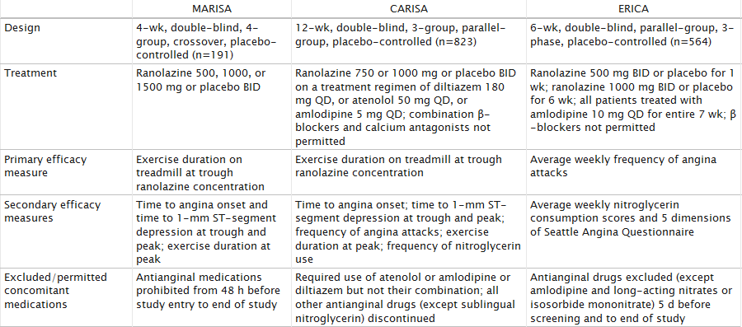
3 ranolazine trials

Slide 15
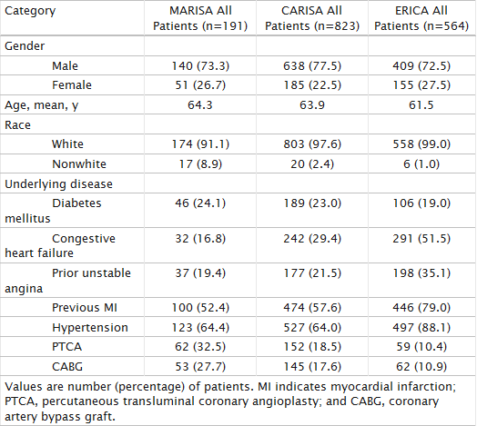
Baseline characterstics

Slide 16
MERLIN TIMI 36: SUMMARY AND IMPLICATONS
In patients with ACS ranolazine added to standard therapy was associated with
No difference in:
Composite efficacy endpoint of CV death, MI, reccurent ischemia
Safety endpoints of all cause death, CV hospitalization or symptomatic documented arryhmia.
Significant reduction in arrhythmias detected by Holter in first 7 days.

Slide 17
Contraindications
Increases the QT interval on the electrocardiogram.
Mean increase in the corrected QT interval (QTc) is approximately 6 msec, about 5% of individuals may have QTc prolongations of 15 msec or longer. (MARISA)
Clinical experience in coronary syndrome population did not show an increased risk of proarrhythmia or sudden death
Strong CYP3A4 inhibitors and drugs that interact with P glycoprotein

Slide 18
Contd…
INTERACTS with:
Digoxin , simvastatin ,cyclosporine, diltiazem, verapamil, ketoconazole, macrolides , grape fruit juice

Slide 19
Other beneficial effects
HbA1c reduction in coronary artery disease patients with diabetes and anti-arrhythmic benefits according to the results of MERLIN TIMI 36 trial. (FDA Approved)
Uses in heart failure (RALI-DHF) and neuropathic pain are being studied .

Slide 20
Side effects
The most common adverse events that led to discontinuation vs placebo were
Dizziness (1.3% versus 0.1%) Nausea (1% versus 0%) Asthenia, Constipation Headache (each about 0.5% versus 0%).
Doses above 1000 mg twice daily are poorly tolerated.

Slide 21
Sinus node inhibition: Ivabradine
SA node
AV node
Common bundle
Bundle branches
Purkinje fibers
.
Notes:
Ivabradine selectively targets the Na⁺/K⁺ current (I_{f} current) in pacemaker cells of the sinoatrial node.
Channels that carry the I_{f} current are unique to the sinoatrial node, although ion channels in the retina have a similar structure and are probably the source of mild, transient visual disturbances in some patients taking I_{f} blockers.¹
Sinus node inhibition: Ivabradine
Tardif J-C, Ford I, Tendera M, Bourassa MG, Fox K, for the INITIATIVE Investigators. Efficacy of ivabradine,
a new selective I_{f} inhibitor, compared with atenolol in patients with chronic stable angina. Eur Heart J. 2005;26:2529-2536.

Slide 22
Sinus node inhibition: Ivabradine
I_{f} current is an inward Na+/K+ current that activates pacemaker cells of the SA node
Ivabradine
  Selectively blocks I_{f} in a current-dependent fashion
  Reduces slope of depolarization, slowing HR
Control
Ivabradine 0.3 µM
40
20
0
Time (seconds)
0.5
–20
–40
–60
Potential (mV)
Notes:
Ivabradine selectively targets the Na⁺/K⁺ current (I_{f} current) in pacemaker cells of the sinoatrial node.
Channels that carry the I_{f} current are unique to the sinoatrial node, although ion channels in the retina have a similar structure and are probably the source of mild, transient visual disturbances in some patients taking I_{f} blockers.¹
Sinus node inhibition: Ivabradine
Tardif J-C, Ford I, Tendera M, Bourassa MG, Fox K, for the INITIATIVE Investigators. Efficacy of ivabradine,
a new selective I_{f} inhibitor, compared with atenolol in patients with chronic stable angina. Eur Heart J. 2005;26:2529-2536.

Slide 23
Trials associated
INITIATIVE TRIAL:
Double blind RCT
compared ivabradine (5, 7.5 and 10 mg bid) with atenolol at doses of 50 and 100 mg per day and
found to be non inferior.
It is safe agent and no changes in QT interval.
ASSOCIATE Trial is
Double blind RCT done on 889 patients
Ivabradine better than placebo in anti anginal and anti ischaemic efficacy.
Combination of this drug and beta blockers was definitely effective without untoward effects.

Slide 24
BEAUTifUL TRIAL-post hoc analysis
The BEAUTIFUL Trial
Analyzed, post hoc, the effect of ivabradine in patients with limiting angina
Patients with limiting angina -13.8% of the trial population.
24% reduction in the primary endpoint [cardiovascular mortality or hospitalization for fatal and non-fatal myocardial infarction (MI) or heart failure HR, 0.76; 95% CI, 0.58–1.00] and

Slide 25
Contd…
A 42% reduction in hospitalization for MI (HR, 0.58; 95% CI, 0.37–0.92).
In patients with heart rate ≥70 bpm, there was a 73% reduction in hospitalization for MI (HR, 0.27; 95% CI, 0.11–0.66) and
A 59% reduction in coronary revascularization (HR, 0.41; 95% CI, 0.17–0.99).
Results indicate that ivabradine is most helpful to reduce adverse cardiac events in patients with limiting angina and its benefits extend beyond symptom control.

Slide 26
Side effect /effects
Blurring of vision
No QT prolongation
No negative inotropic properties
Improvements in exercise tolerance and prevention of exercise-induced ischaemia

Slide 27
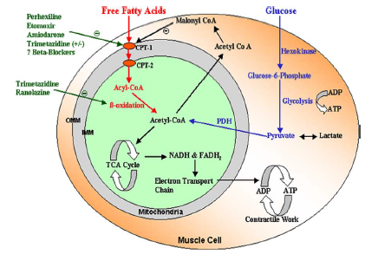
Cardiac metabolism

Slide 28
Cardiac metabolism- LCFAs are the major source of energy (80%) and Glucose (20%) in aerobic conditions.

Slide 29
Metabolic modulation (pFOX): Trimetazidine
Myocytes
FFA
Glucose
O2 requirement of glucose pathway is lower than FFA pathway
During ischemia, oxidized FFA levels rise, blunting the glucose pathway
Acyl-CoA
Pyruvate
β-oxidation
Trimetazidine
Acetyl-CoA
Energy for contraction
pFOX = partial fatty acid oxidation
FFA = free fatty acid
.
Notes:
The free fatty acid oxidation hypothesis arose out of advances in understanding of myocardial metabolic pathways.
Myocardial cells derive their energy via fatty acid and glucose metabolism. During ischemia the fatty acid pathway predominates. However, this pathway requires more oxygen than the glucose pathway.¹
Theoretically, inhibition of fatty acid oxidation should promote a shift towards the more oxygen-efficient glucose pathway.
Lopaschuk et al and Stanley have reported experimental data showing that the antianginal trimetazidine is an inhibitor of partial fatty acid oxidation (pFOX). However, MacInnes et al did not observe any inhibition with trimetazidine in other experimental models.
Thus, inhibition of fatty acid oxidation as a major antianginal mechanism for trimetazidine remains to be definitively established.
Metabolic modulation (pFOX): Trimetazidine
Chaitman BR, Skettino SL, Parker JO, Hanley P, Meluzin J, Kuch J, et al, for the MARISA Investigators. Anti-ischemic effects and long-term survival during ranolazine monotherapy in patients with chronic severe angina. J Am Coll Cardiol. 2004;43:1375-1382.

Slide 30
No significant negative inotropic or vasodilator properties either at rest or during dynamic exercise
TRIMPOL II –RCT of 426 patients with CSA
Trimetazidine 20 mg three times a day vs placebo in addition to metoprolol 50mg.
Improvement in :
Time to ST segment depression on exercise tolerance testing (ETT),
Total exercise workload,
Mean nitrate consumption, and angina frequency

Slide 31
EMIP-FR trial:
19000 post mi patients
Showed no benefit of iv infusion of trimetazidine immediately post MI over 48hrs
VASCO Trial
Largest RCT
Showed no benefit as an add on in angina
MOA – CPT -1 inhibitor and also acts in inhibition of the enzyme long-chain 3-ketoacyl coenzyme A thiolase (LC 3- KAT)
Safety issues and adverse effects ?????

Slide 32
Side effects
Extrapyramidal and parkinsonian symptoms recently published by EMA 2012
Restless leg syndrome.
Use is limited in severe renal impairment.

Slide 33
Perhexilene
Earlier designed as a CCB but does not act like a CCB
Does not affect the heart rate or SVR
Multiple randomized trials show that it has anti anginal effect as monotherapy or in combination.
Inhibition of CPT-1 and, to a lesser extent, CPT-2, resulting in increased glucose and lactate utilisation

Slide 34
S/E hepatotoxicity and peripheral neuropathy
Cole et al confirmed the safety of perhexiline in a
randomised, double-blind, crossover study following initiation of 100 mg of perhexiline BD with subsequent
plasma-guided dose titration; none of the patients devloped any dreaded side effects.
Other s/e: nausea ,dizziness and hypoglycemia
Other uses – symptomatic Aortic stenosis

Slide 35
Etomoxir/ Oxfenicine
Potential anti anginal agent
Launched as anti diabetic agent due to hypoglycaemic effects
CPT 1 INHIBITOR
Improvement in LV function in rats- Turcani & Rupp
Single study available on humans (15 patients) with NYHA II – III Etomoxir 80mg was administered.
Only animal studies on oxfenicine.

Slide 36
Preconditioning: Nicorandil
Activation of ATP-sensitive K⁺ channels
Ischemic preconditioning
Dilation of coronary resistance arterioles
N
O
HN
O
NO₂
Nitrate-associated effects
Vasodilation of coronary epicardial arteries
IONA Study Group. Lancet. 2002;359:1269-75.
Rahman N et al. AAPS J. 2004;6:e34.
Notes:
Nicorandil possesses a nitrate moiety and, therefore, produces hemodynamic effects similar to those of long-acting nitrates.
It activates cyclic GMP (cGMP), dilates capacitance vessels, and decreases preload.
Nicorandil is also capable of opening ATP-sensitive K⁺ (K_{ATP}) channels. These channels are involved in dilation of coronary resistance arterioles, which decreases afterload, and are also thought to mimic ischemic preconditioning, a potential cardioprotective effect.
Preconditioning: Nicorandil

Slide 37
DOSAGE- 20mg bid
Tolerance with chronic dosage
No cross tolerance with nitrates
The Impact Of Nicorandil in Angina (IONA) trial - significant reduction of major coronary events in stable angina patients treated with nicorandil compared with placebo as add-on to conventional therapy
Also used in unstable angina. It also reduces the number of further attacks
Additive effects with nitrates

Slide 38
Rho kinase inhibition: Fasudil
Rho kinase triggers vasoconstriction through accumulation of phosphorylated myosin
Ca²⁺
Ca²⁺
Agonist
Receptor
PLC
PIP₂
Rho
IP₃
Fasudil
Rho kinase
SR Ca²⁺
Myosin
MLCK
Myosin phosphatase
Ca²⁺
Myosin-P
Calmodulin
Notes:
The role of Ca²⁺ in activating myosin light chain kinase (MLCK) and phosphorylating myosin to cause contraction is well known.
Dephosphorylation by myosin phosphatase causes subsequent dilation.
More recently, the involvement of Rho kinase has been identified.
In the absence of increases in intracellular Ca²⁺, Rho (a member of the Ras superfamily of small G proteins) activates Rho kinase, which in turn deactivates myosin phosphatase. This causes accumulation of phosphorylated myosin.
Other abbreviations used in the figure:
IP₃ = inositol triphosphate
PIP₂ = phosphatidylinositol biphosphate
PLC = phospholipase C
ROC = receptor-operated channel
SR = sarcoplasmic reticulum
VOC = voltage-operated channel
Rho kinase inhibition: Fasudil

Slide 39
Fasudil up to 80 mg three times daily significantly increased the ischemic threshold of angina patients during exercise with a trend toward increased exercise duration.
Double-Blind, Placebo-Controlled, Phase 2 Trial on 84 patients

Slide 40
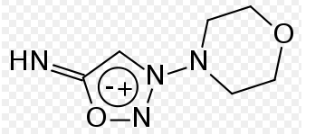
Molsodomine & linsodomine
Anti anginal and anti ischaemic
Acts like nitrates
Metabolises in liver to form linsodomine
Orally active
Metabolised in liver

Slide 41
TMLR
Surgical
surgeons use the laser to make holes between 20 and 40 tiny (one-millimeter-wide)
Surgical incision made
Done along with CABG sometimes

Slide 42
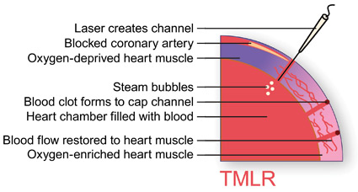

Slide 43
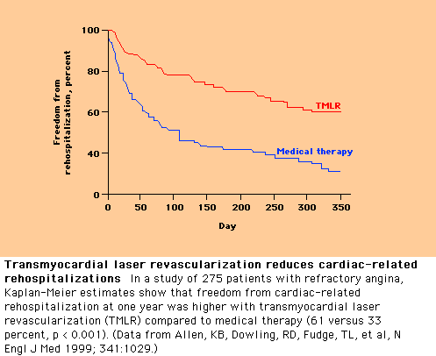

Slide 44
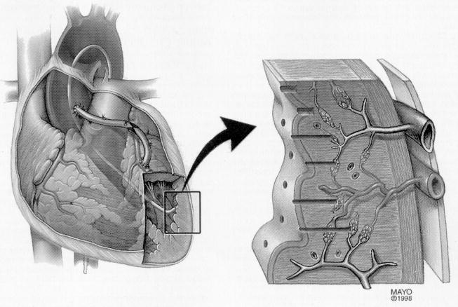
Percutaneous TMR

Slide 45

Rationale
Improved perfusion by stimulation of angiogenesis
Potential placebo effect
Anesthetic effect mediated by the destruction of sympathetic nerves carrying pain-sensitive afferent fibers

Slide 46
TMLR – Direct Trial
Only major blinded study
  298 pts with low dose, high dose, or no laser channels
No benefit to TMLR vs Med therapy to
  Patient survival
  Angina class
  Quality of life assessment
  Exercise duration
  Nuclear perfusion imaging
  Leon MB, et al. JACC 2005; 46:1812
High Surgical Risk (Mortality 5%)
Mainly used as adjunct therapy during CABG to treat myocardium that cannot be bypassed.

Slide 47
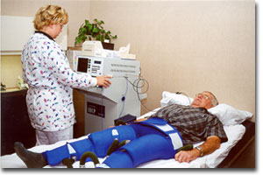
Enhanced external counterpulsation

Slide 48
EECP
Increases arterial blood pressure and retrograde aortic blood flow during diastole (diastolic augmentation).
Cuffs are wrapped around the patients legs and sequential pressure (300mmHg) is applied in early diastole.
3 pairs of cuffs

Slide 49
Patient selection
Angina class III/IV
  Refractory to medical therapy
  Reversible ischemia of the free wall
  not amenable for revascularization
Excluded if LVEF<20% or had current major illness

Slide 50
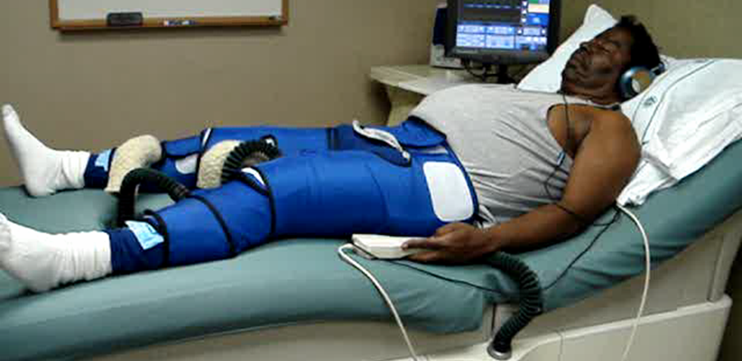
EECP - Enhanced External CounterPulsation
External, pneumatic compression of lower extremities in diastole.

Slide 51
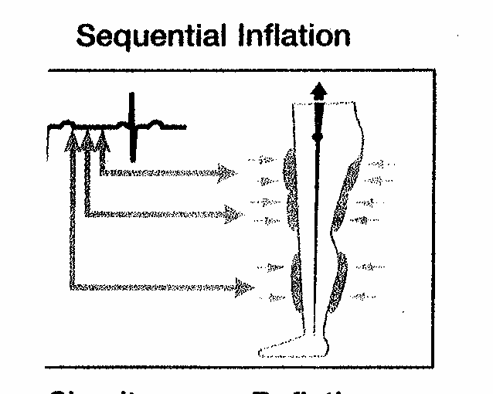
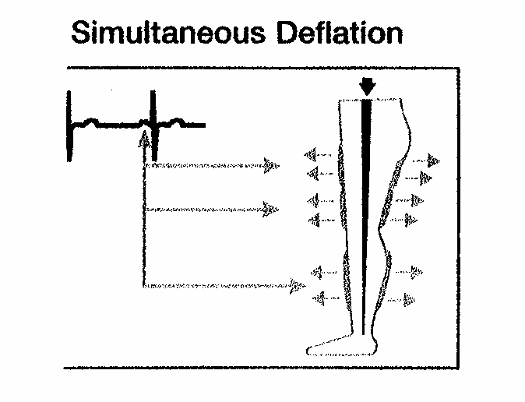
EECP - Enhanced External CounterPulsation

Slide 52
EECP - Enhanced External CounterPulsation
Sequential inflation of cuffs
Retrograde aortic pressure wave
Increased Coronary perfusion pressure
Increased Venous Return
Increased Preload
Increased Cardiac Output
Simultaneous deflation of cuffs in late Diastole
Lowers Systemic Vascular Resistance
Reduced afterload
Decreased Cardiac workload
Decreased Oxygen Consumption

Slide 53
EECP - Enhanced External CounterPulsation
35 total treatments
  5 days per week x 7 weeks
  1 hour per day
Appears to reduce severity of Angina
Not shown to improve survival or reduce myocardial infarctions
Indicated for CAD not amenable to revascularization
May be beneficial in treatment of refractory CHF too, but generally this is not an approved indication.

Slide 54
EECP – Contraindications & Precautions
Arrhythmias that interfere with machine triggering
Bleeding diathesis
Active thrombophlebitis & severe lower extremity vaso-occlusive disease
Presence of significant AAA
Pregnancy

Slide 55
MUST EECP
Blinded RCT on 139 patients to check the safety and efficacy of EECP
Patients with CSA were given 35hrs of EECP/WK
Exercise duration increased .
Time to ≥1-mm ST-segment depression increased significantly
Patients saw a decrease in angina episodes (p < 0.05). Nitroglycerin usage decreased.

Slide 56
Chelation Therapy
IV EDTA infusions
  30 treatments over about 3 months
  Aggressive marketing
  PLACEBO effect only
Claimed pathophysiologic effects
  Liberation of Calcium in plaque
  Lower LDL, VLDL, and Iron stores
  Inhibit platelet aggregation
  Relax vasomotor tone
  Scavenge “free radicals”

Slide 57
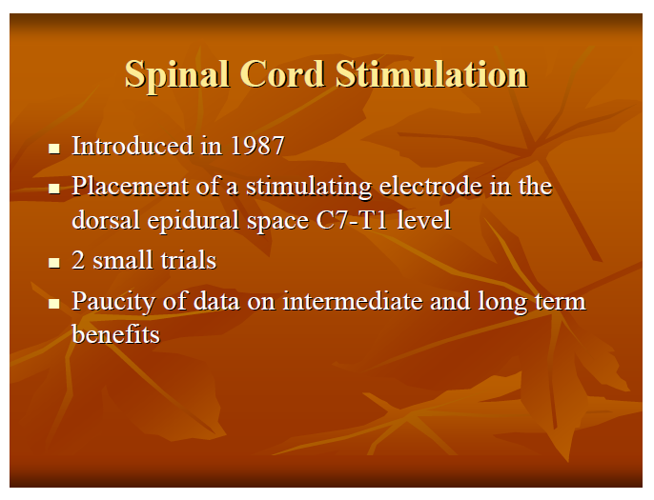

Slide 58
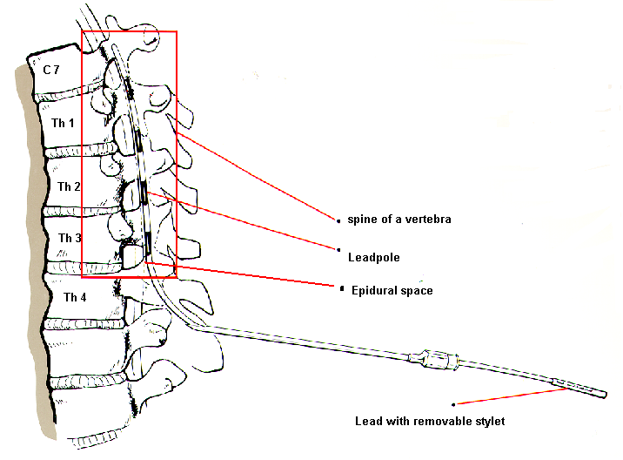
Spinal Cord Stimulation
power source
conducting wires
electrodes at
stimulation site
Stimulation typically
administered for 1-2 hrs tid
Therapeutic mechanism appears to be alteration of anginal pain perception

Slide 59
Long-term Outcomes Following SCS
Prospective Italian Registry: 104 Patients, Follow-up 13.2 Months
* p<0.0001
*
*
*
*
*
*
*
Episodes/wk
(DiPede, et l. AJC 2003;91:951)

Slide 60
Randomized Trial of SCS vs. CABG For Patients with Refractory Angina
104 Patients with refractory angina, not suitable for PCI and high risk for re-op (3.2% of patients accepted for CABG)
*
*
*
*
*P < 0.0001
Spinal cord stimulation (n=53)
CABG (n=51)
No difference in symptom relief between SCS and CABG
(Mannheimer, et al. Circulation 1998;97:1157)

Slide 61
Potential cardioprotective benefits of exercise
NO production
ROS generation
ROS scavenging
Other mechanisms
Vasculature
Myocardium
Thrombosis
Domenech R. Circulation. 2006;113:e1-3.
Kojda G et al. Cardiovasc Res. 2005;67:187-97. Shephard RJ et al. Circulation. 1999;99:963-72.
Notes:
Physical conditioning increases exercise duration and work capacity, prolonging time to angina.
Exercise is associated with cardioprotective benefits beyond improvement in aerobic capacity alone.
Molecular effects:
↑eNOS expression and activation
↓NAD(P)H expression and activity
↓ AT₁ receptor expression
↑SOD expression
Other effects
↓Intimal thickness
↓P selectin
↓VCAM-1
↓MCP-1
↓Ca²⁺ in VSMC
Potential cardioprotective benefits of exercise
Functional effects:
Vasculature
↑Endothelial function
↑Peripheral tone
↑Plasma volume
↓BP
Myocardium
↑Vagal tone
↓HR
↓O₂ demand
↑Preconditioning
Thrombosis
↑Fibrinolytic balance

Slide 62
THANK YOU

Slide 63
BOOK REFERENCES
Braunwald`s heart diseases -10 edition
Cardiovascular medicine 3rd edition –Brian Griffin
Hurst-The Heart -13th edition.
Harrisons Principles of internal medicine –19th edition

